Slide 1
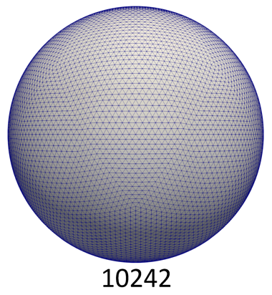
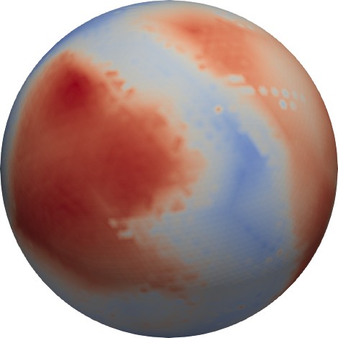
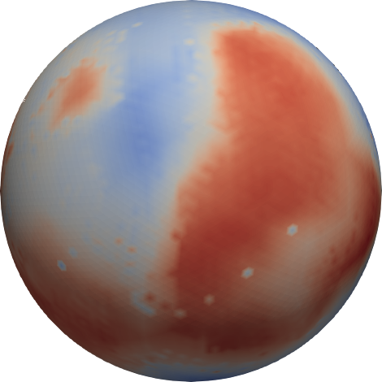
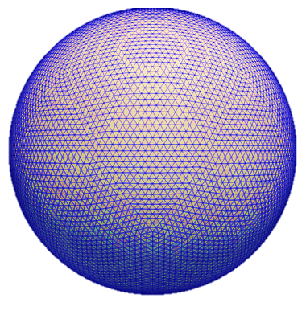
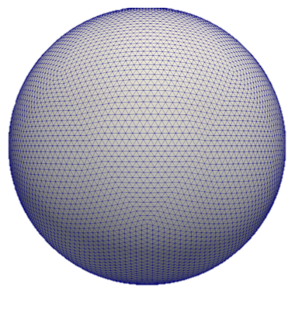
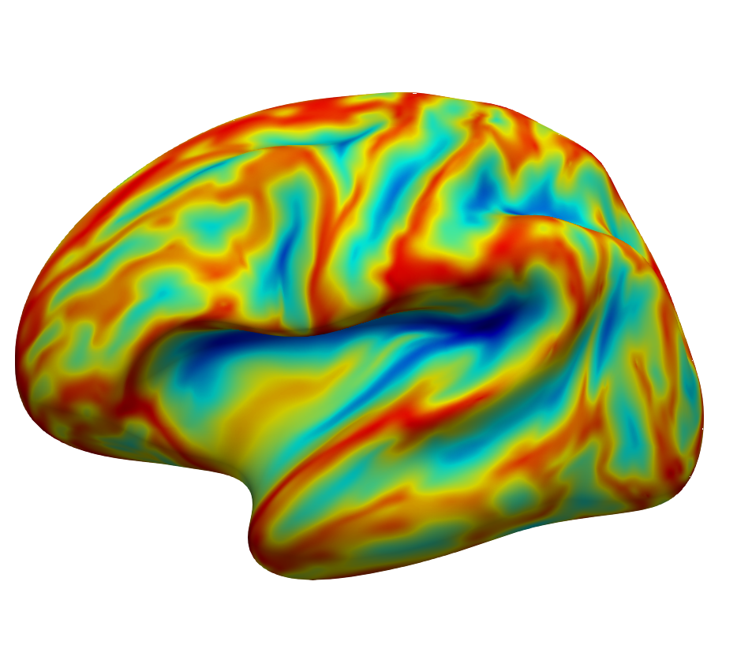
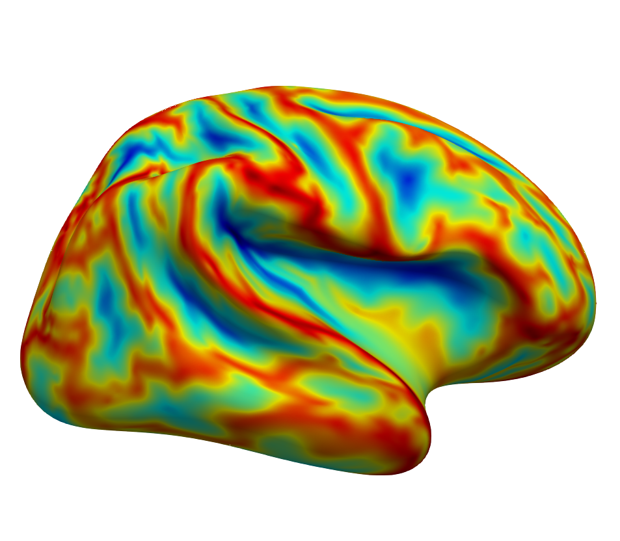
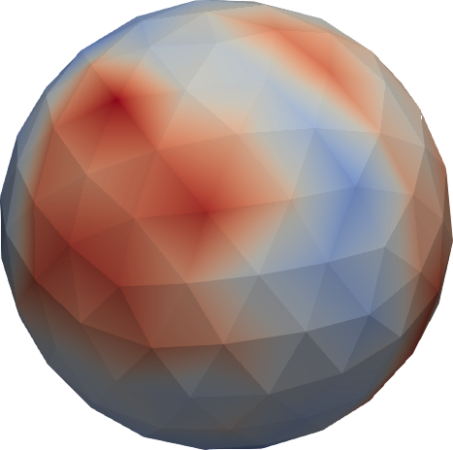
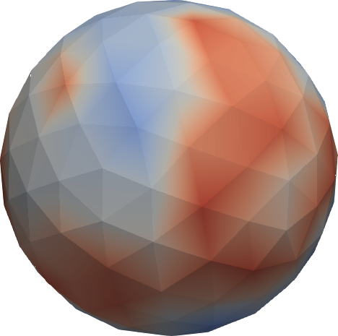
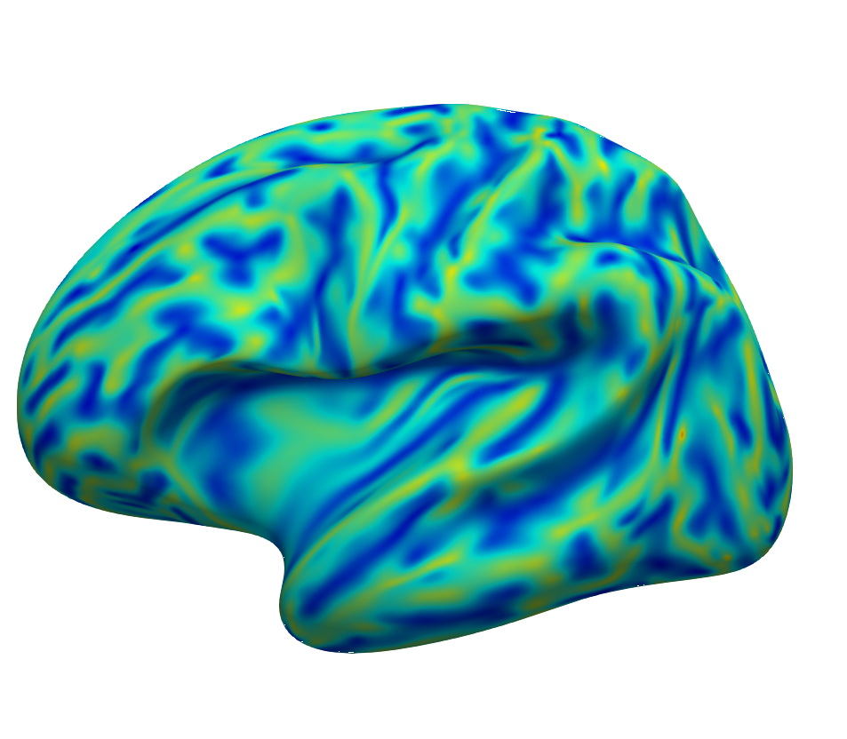
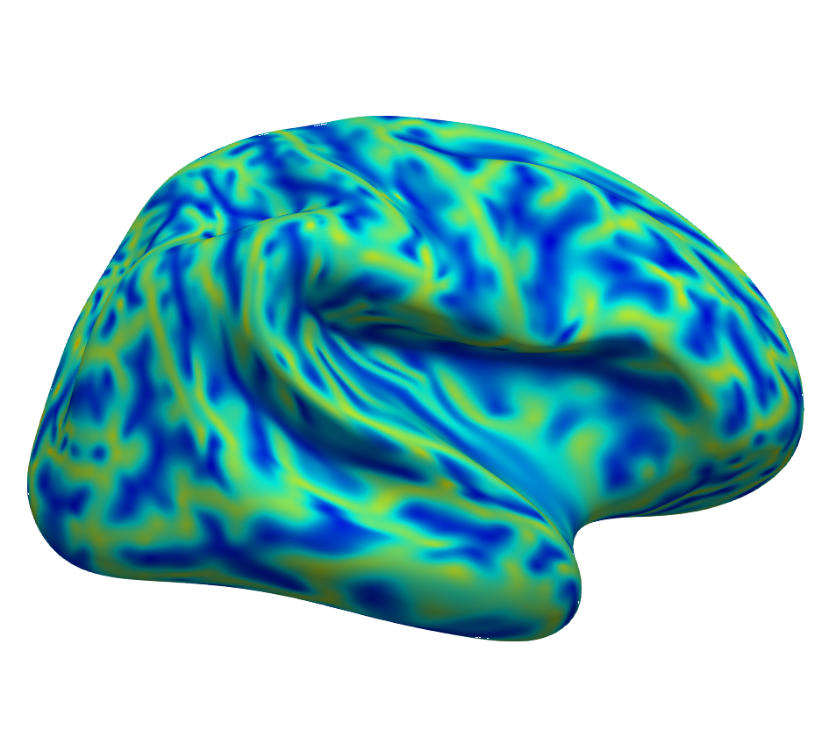
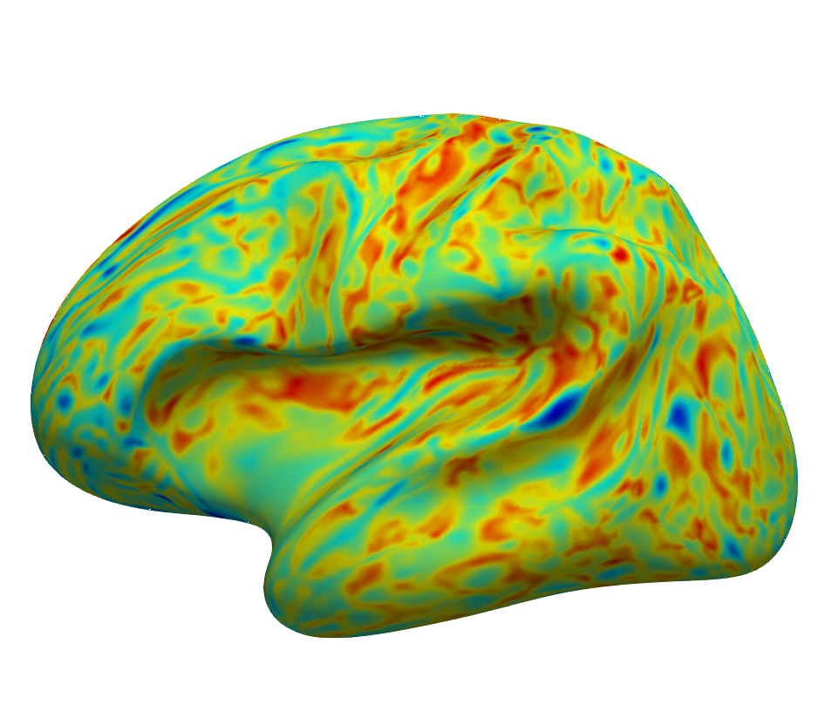
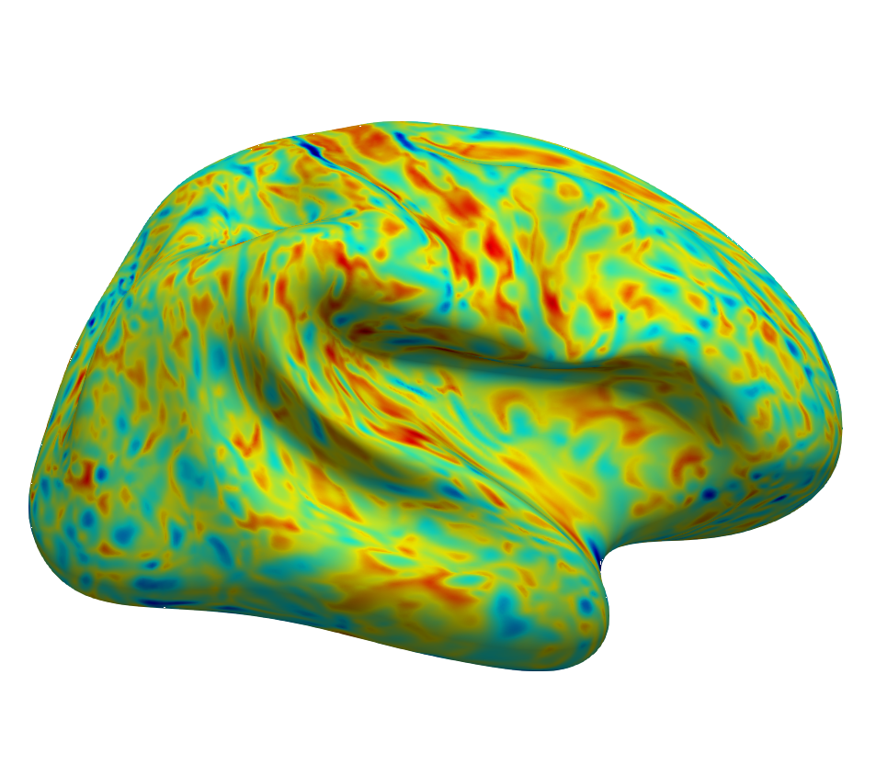
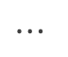

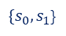

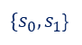


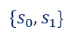
Spherical attention mechanism
Left
Classification score
EB-1
DB-3
A
C
Input features
$$⋯$$
GAP
1D
Conv
$\{s_{0},s_{1}$}
Spherical mapping
$\{s_{0},s_{1}$}
Share weights
Left
Right
$$⋯$$
1D
Conv
Cortical attributes
EB-2
DB-2
A
Left
Right
Left
Right
Right
Convexity
$\{s_{0},s_{1}$}
Attention-gated
features
$$⊙$$
Attention maps
Mean curvature
EB-3
DB-1
A
EB
: Hexagonal Conv + Pooling (except EB-4)
C
: GAP + 1D Conv
$\{s_{0},s_{1}$}
T
: Cross-hemisphere Self-Attention
A
: Spherical Attention Mechanism
Cortical thickness
: Hexagonal Transposed Conv
+ Skip connection
+ Hexagonal Conv
: Dot-product
DB
$$⊙$$
EB-4
T
A
: Concatenation
$\{s_{0},s_{1}$}
: Multiplication

Slide 2
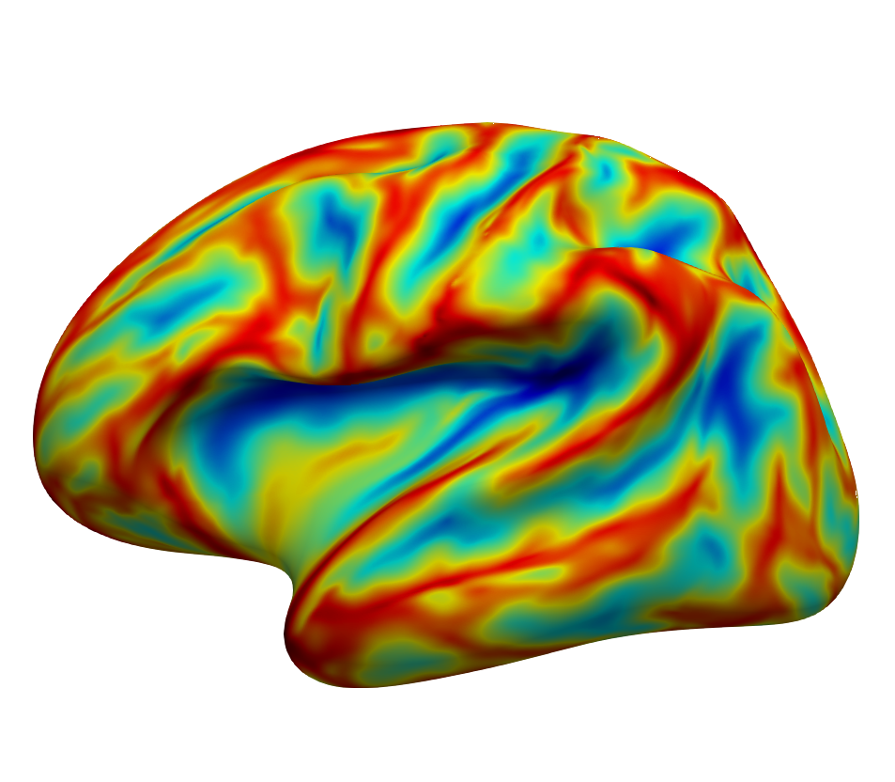
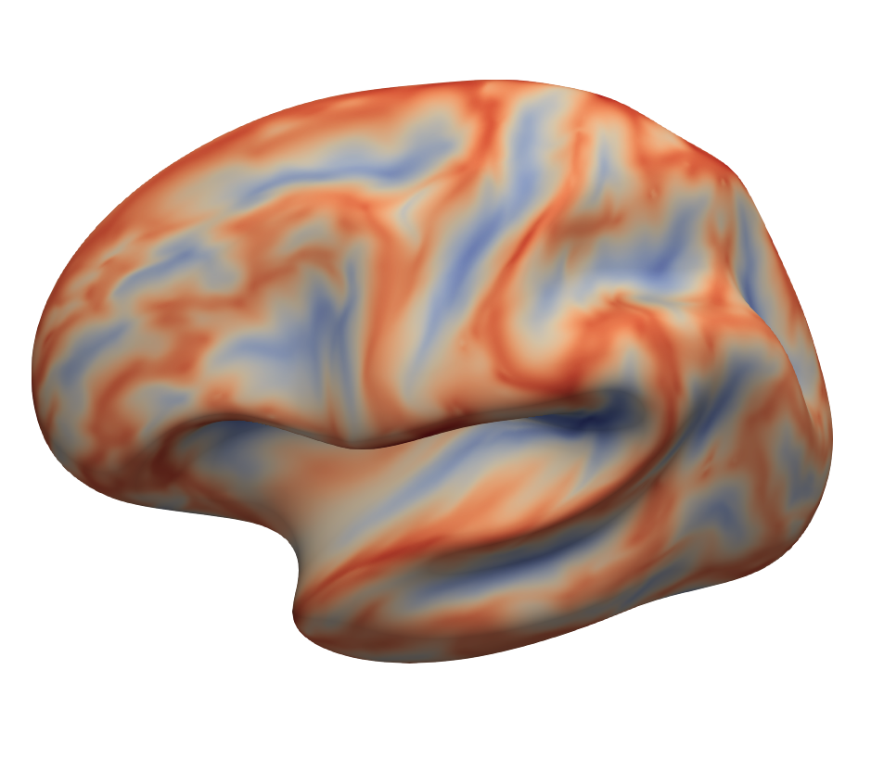
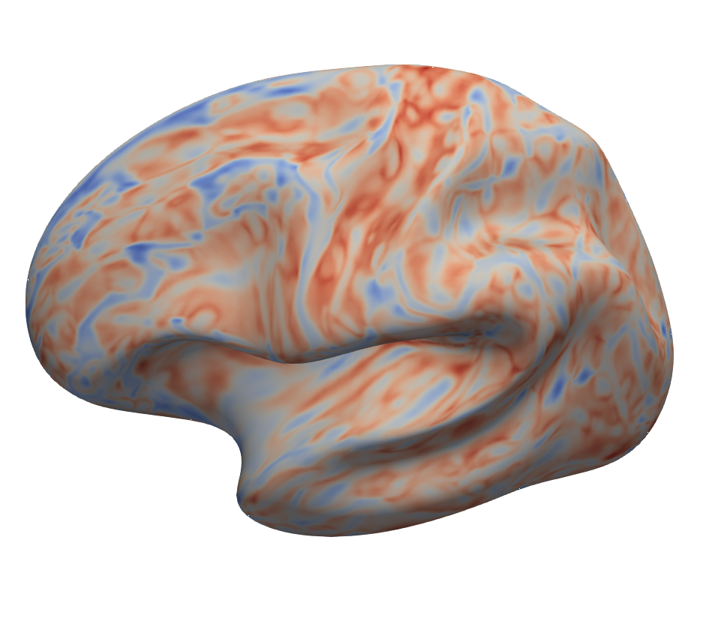
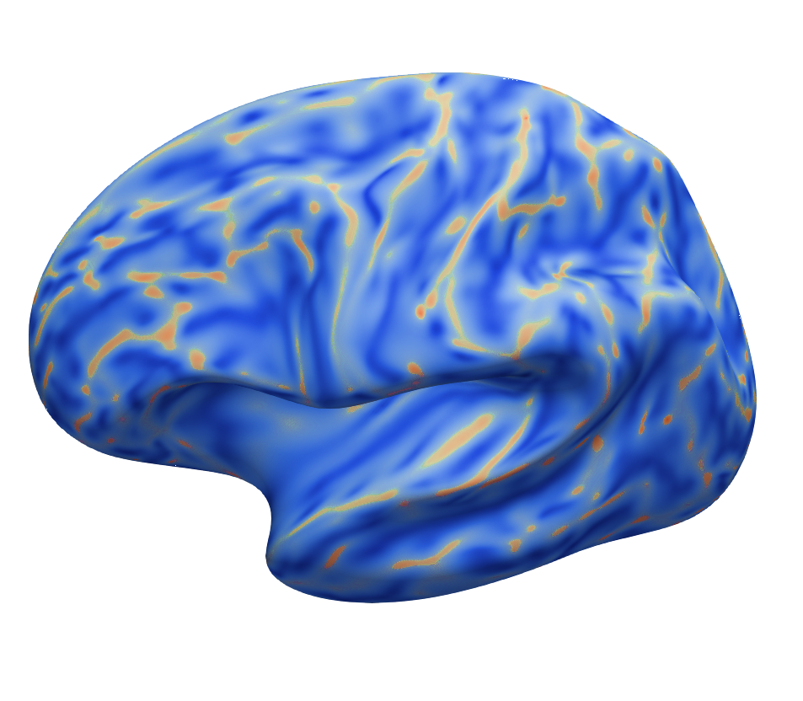
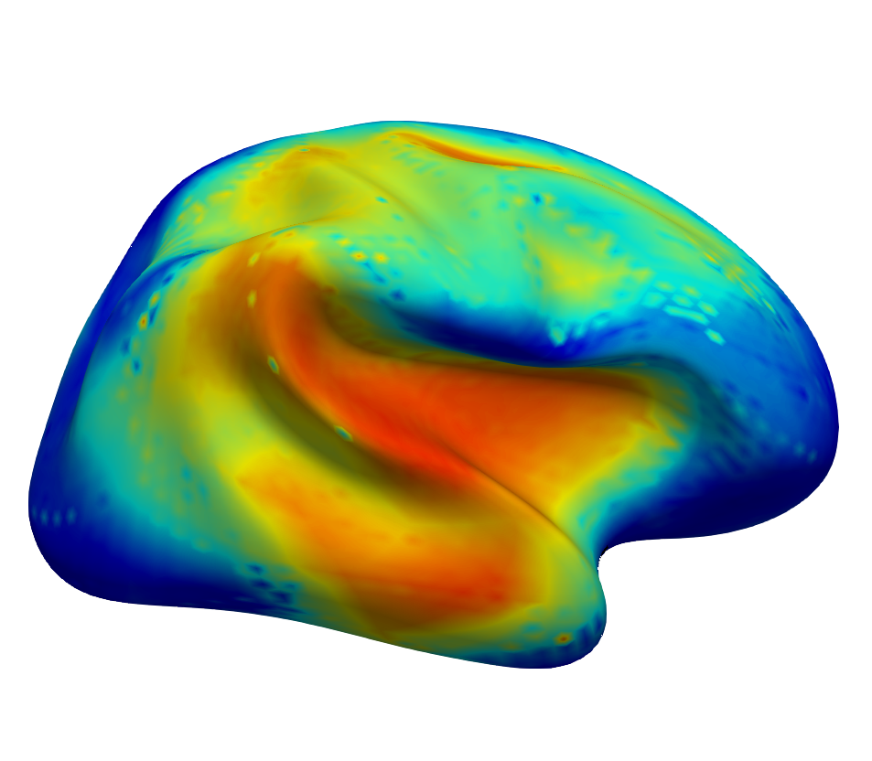
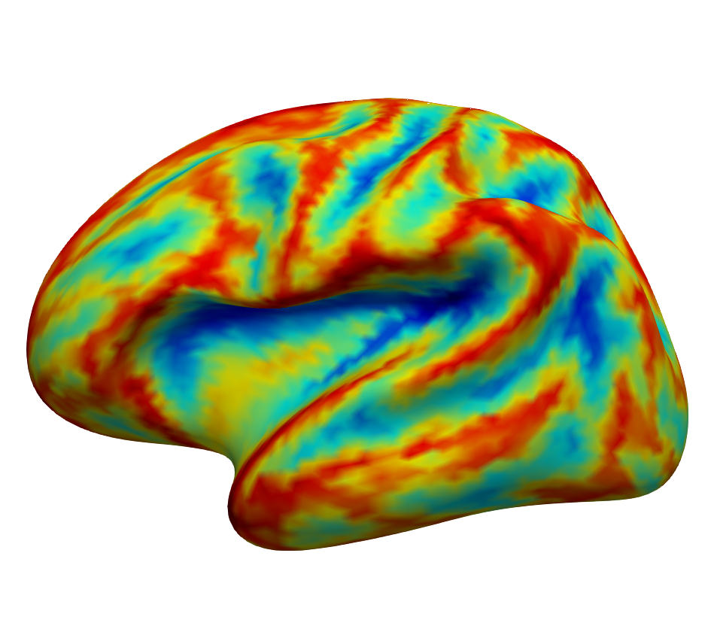


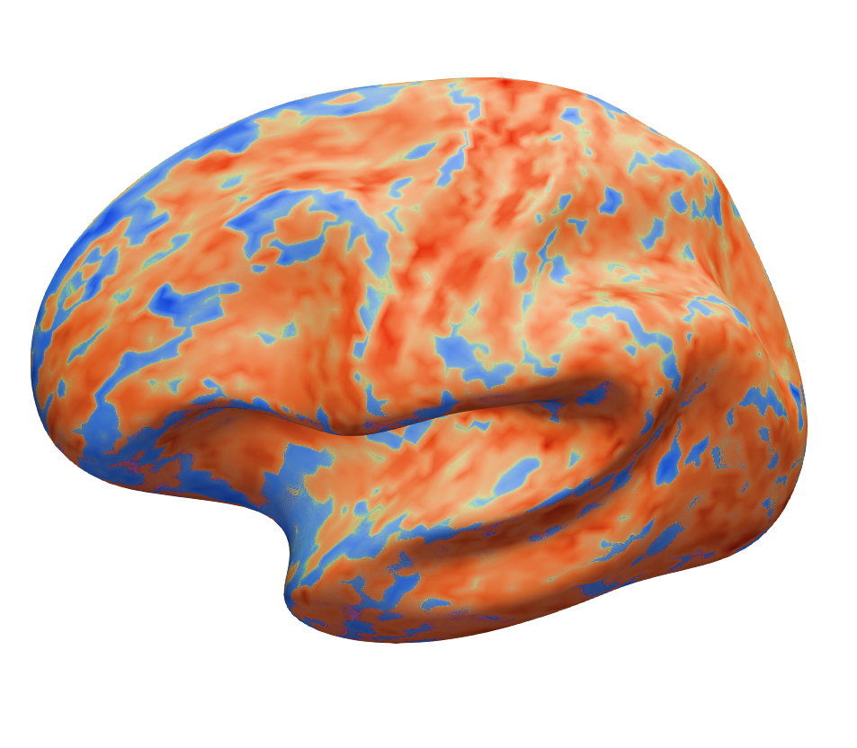
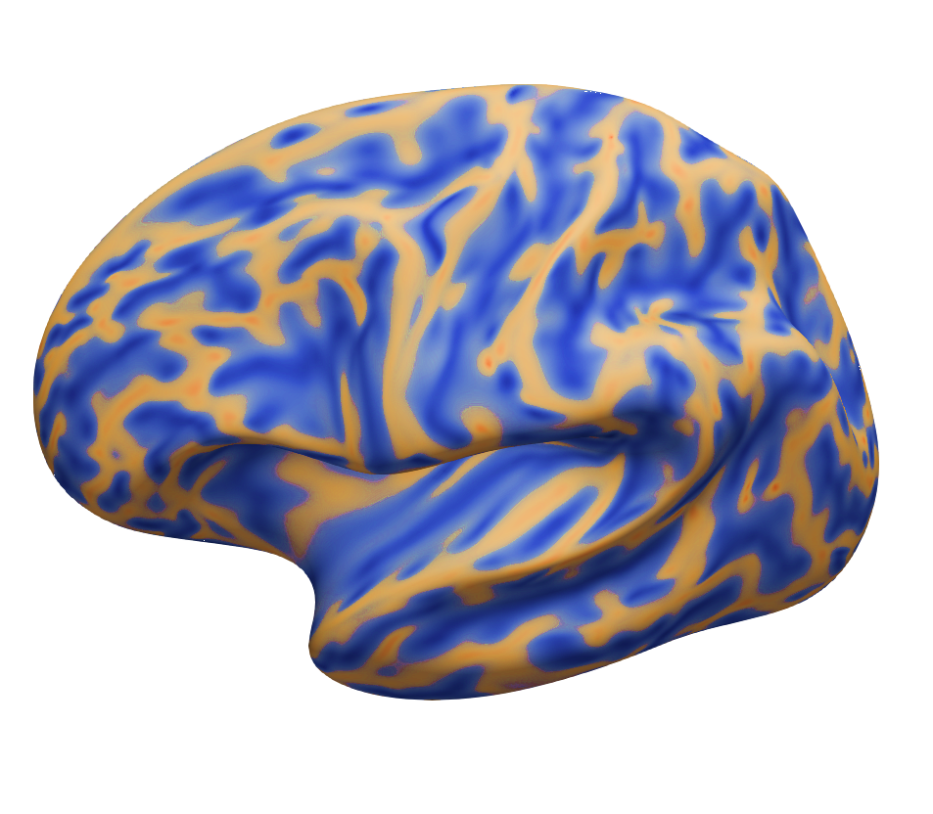
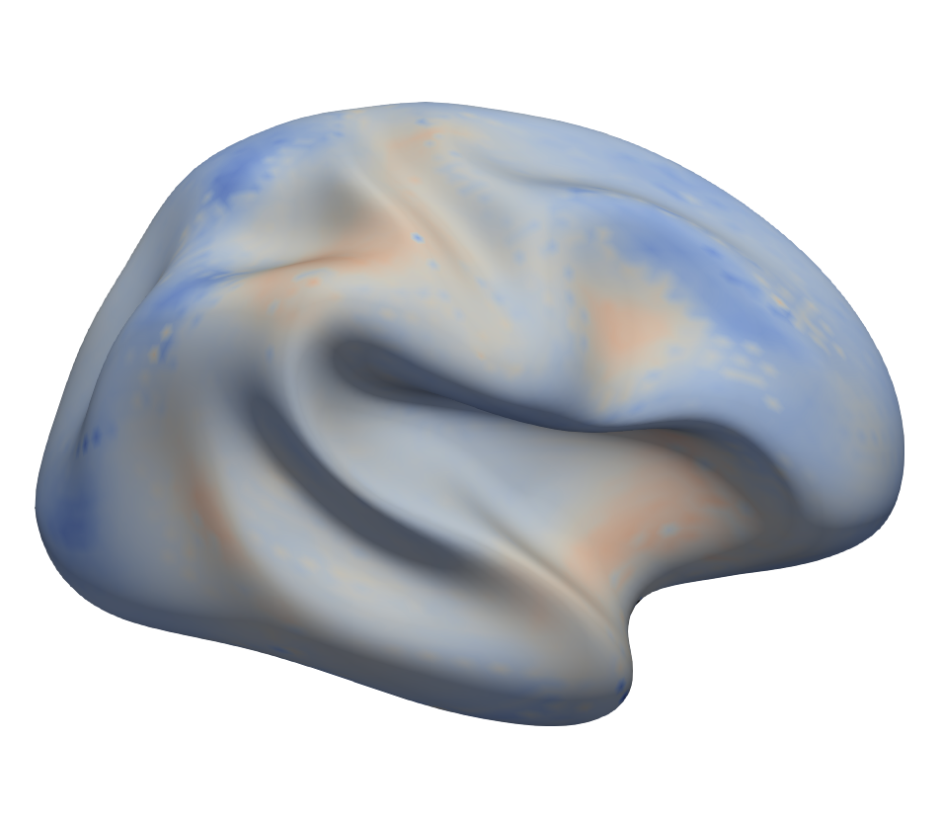
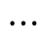
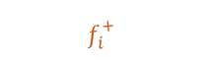
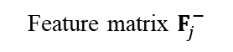
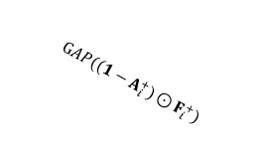
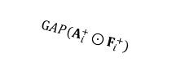
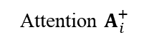
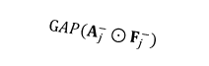
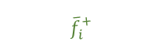
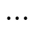
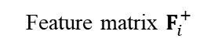
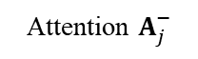
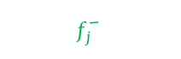
Atypical subject
Discriminative representation space
Original convexity
Feature matrix $F_{i}^{+}$
Attention $A_{i}^{+}$
10
$$⋯$$
$$GAP(A_{i}^{+}⊙F_{i}^{+})$$
$$f_{i}^{+}$$
$$GAP(({1−A}_{i}^{+})⊙F_{i}^{+})$$
-15
Push
Typical subject
$${\overline{f}}_{i}^{+}$$
Random coarsening
Feature matrix $F_{j}^{−}$
Attention $A_{j}^{−}$
Pull
$$⋯$$
$$GAP(A_{j}^{−}⊙F_{j}^{−})$$
$$f_{j}^{−}$$
…
(a)
(b)

Slide 3
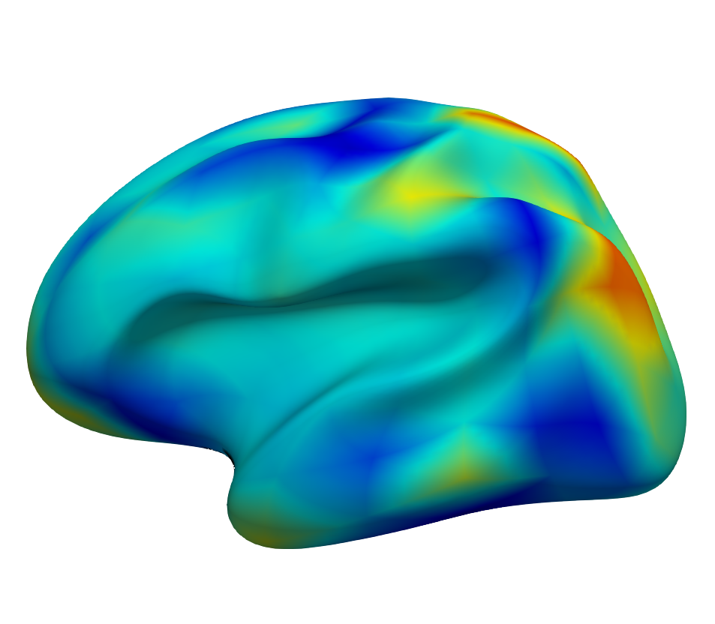
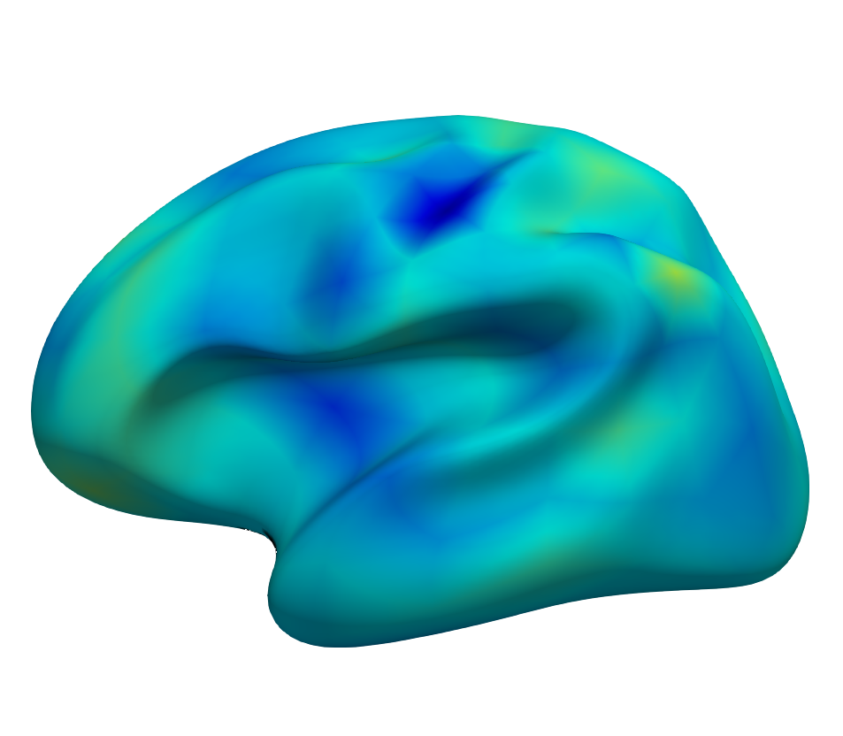
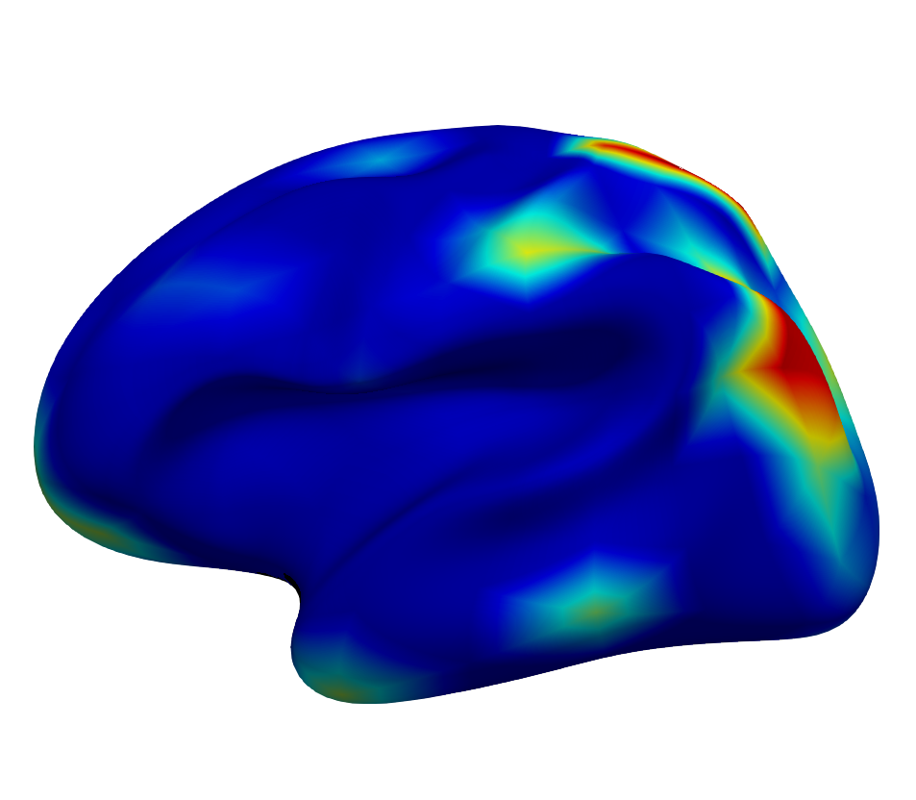
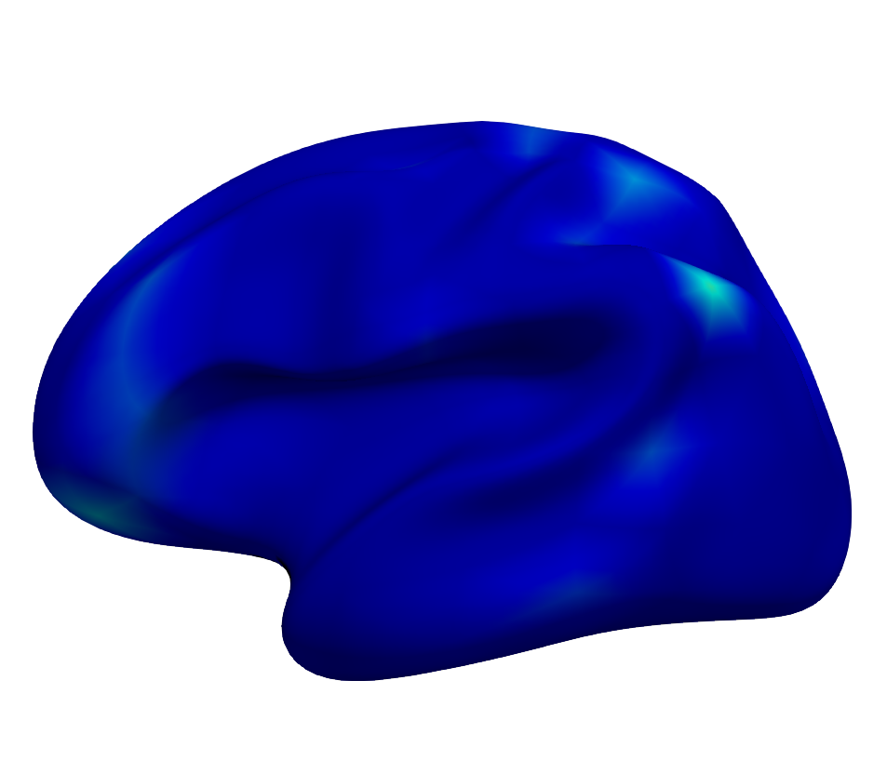
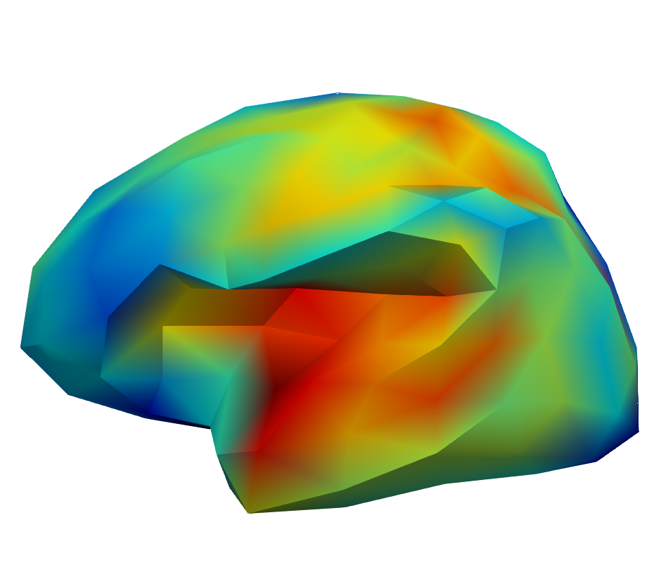
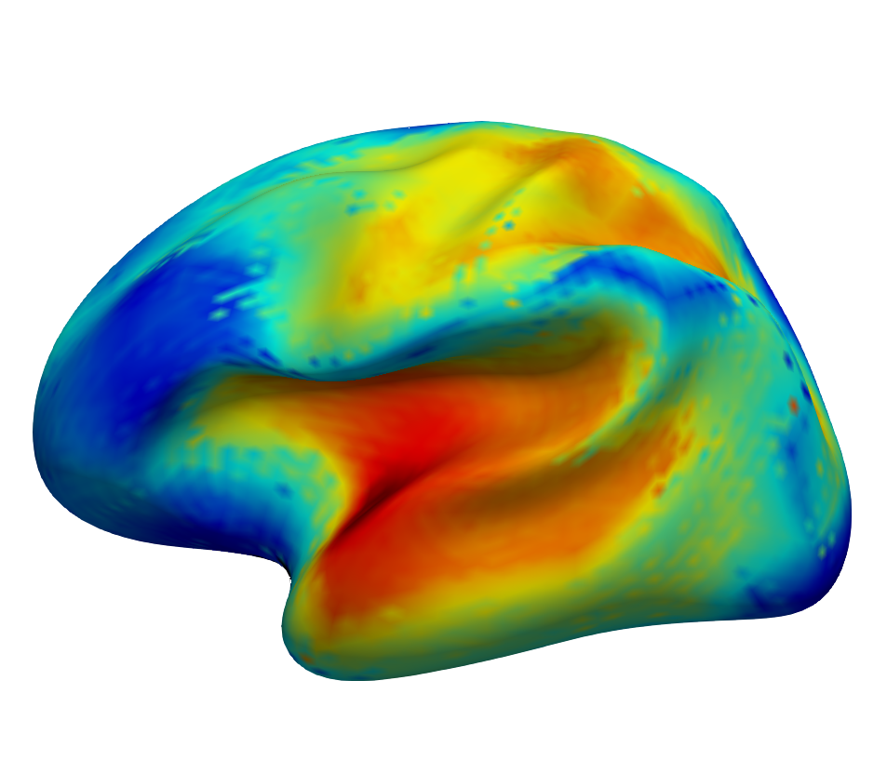
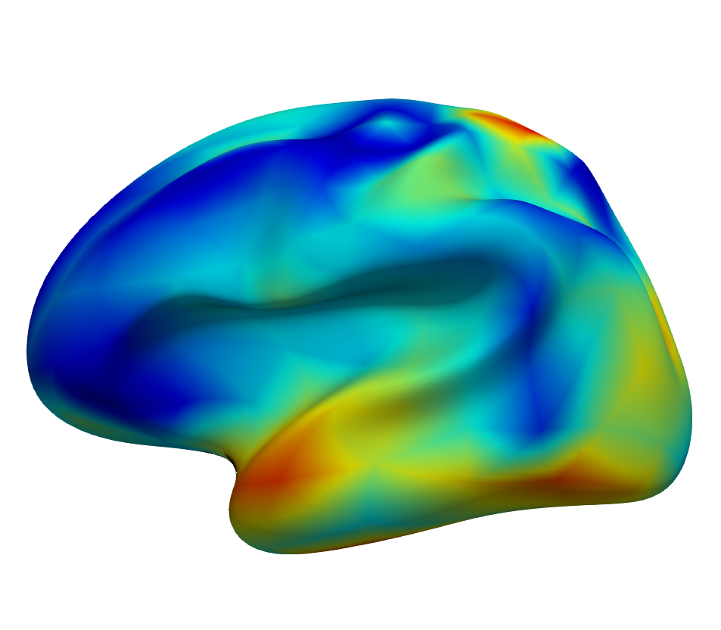
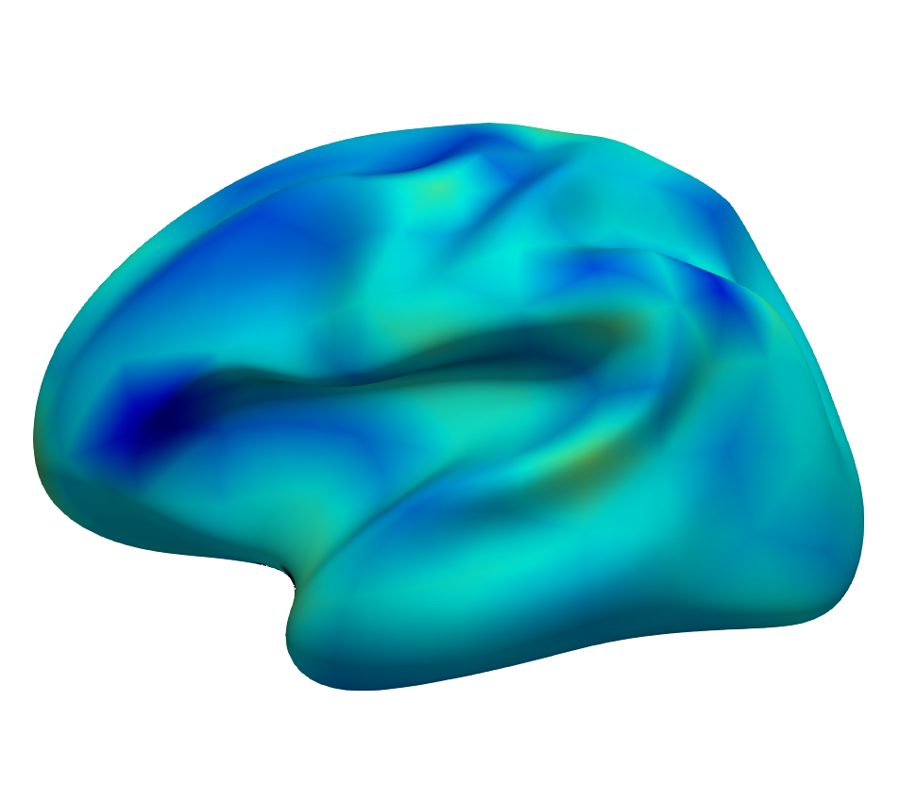
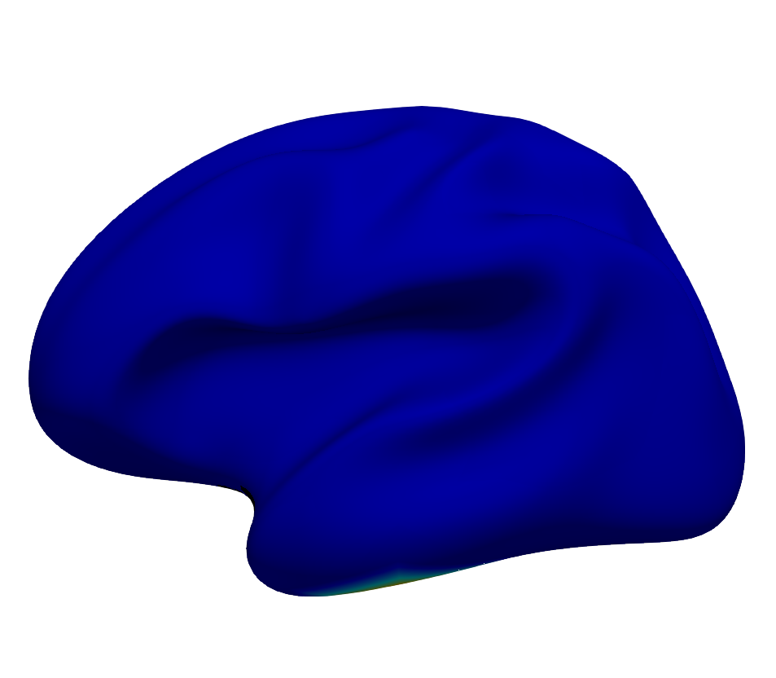
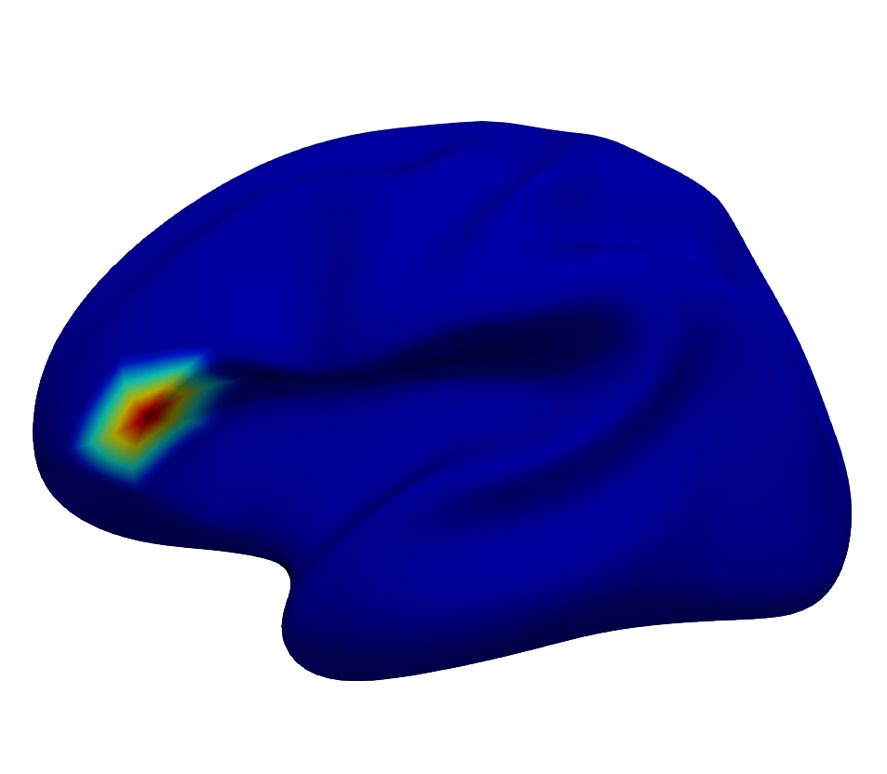
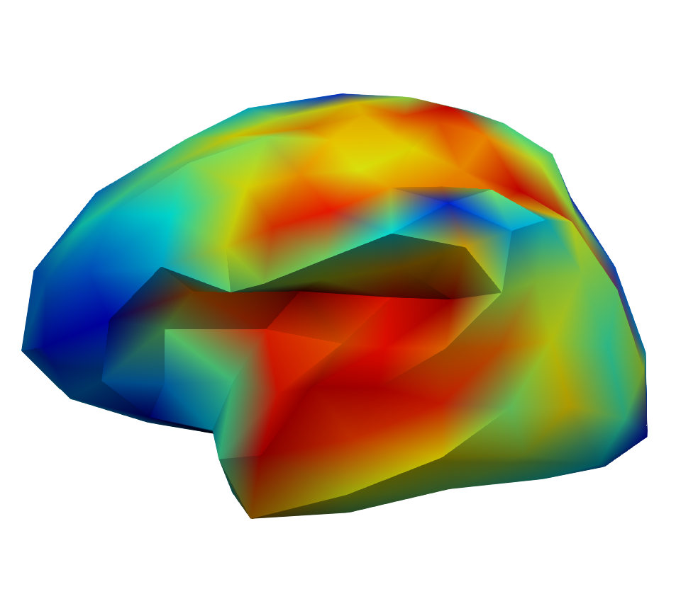
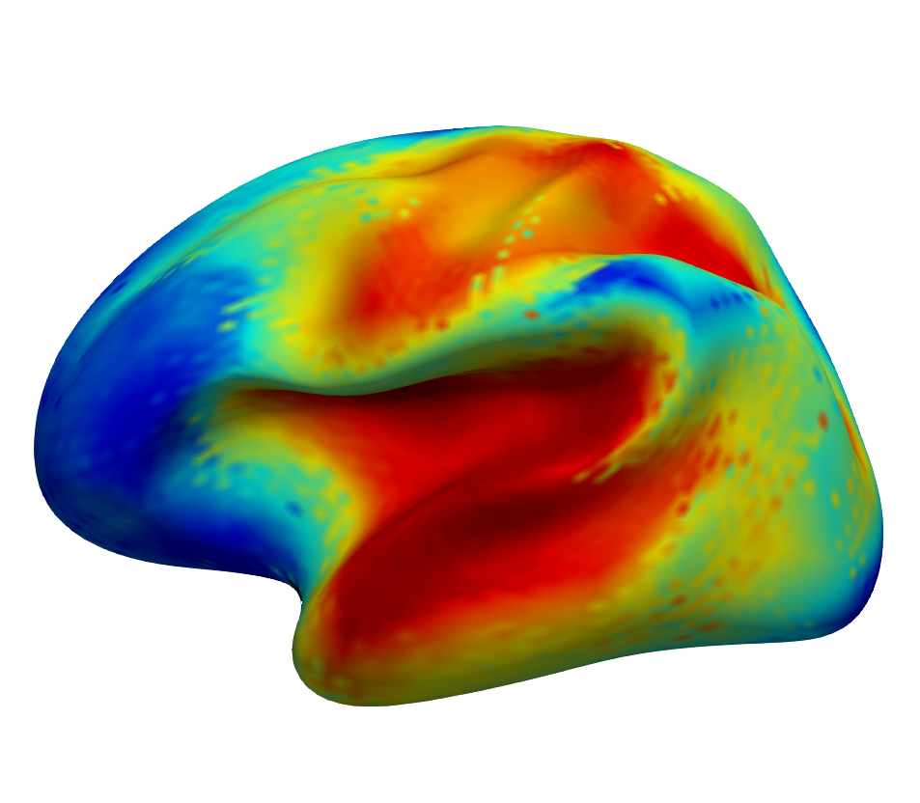



































CAM
Grad-CAM
Ours
CAM
Grad-CAM
Ours
Spherical
CNN
Spherical
MoNet
Spherical
CNN
Spherical
MoNet
Coarse-
scaled
Fine-grained
Spherical
CNN
Spherical
MoNet
Spherical
CNN
Spherical
MoNet
Coarse-
scaled
Fine-grained
1
Left
Right
0
Subject 1
Subject 2

Slide 4







Our NeuroExplainer
Existing Multi-Modal (dMRI + sMRI) Studies
Mean Diffusivity
Neurite Density
Cortical Thickness
-10
1
0
10

